Slide 1
Inheritance in C++

Slide 2
Inheritance
The capability of a class to derive properties and characteristics from another class is called Inheritance.
Inheritance is one of the most important feature of Object Oriented Programming.
Sub Class: The class that inherits properties from another class is called Sub class or Derived Class.
Super Class: The class whose properties are inherited by sub class is called Base Class or Super class.

Slide 3

Why and When to Use Inheritance
Consider a group of vehicles. You need to create classes for Bus, Car and Truck. The methods fuelAmount(), capacity(), applyBrakes() will be same for all of the three classes.
If we create these classes avoiding inheritance then we have to write all of these functions in each of the three classes as shown in below figure:

Slide 4
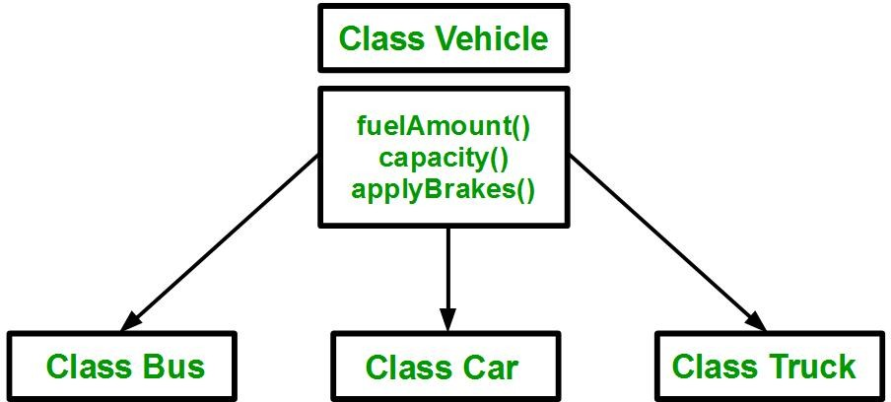
Why and When to Use Inheritance
You can clearly see that above process results in duplication of same code 3 times. This increases the chances of error and data redundancy. To avoid this type of situation, inheritance is used. If we create a class Vehicle and write these three functions in it and inherit the rest of the classes from the vehicle class, then we can simply avoid the duplication of data and increase re-usability.

Slide 5
Why and When to Use Inheritance
Look at the above diagram in which the three classes are inherited from vehicle class.
Using inheritance, we have to write the functions only one time instead of three times as we have inherited rest of the three classes from base class(Vehicle).

Slide 6
Advantages of Inheritance
It saves memory space.
It saves time.
It increases reliability of the code
It saves developing and testing efforts.
Data abstraction.
Data reusability

Slide 7
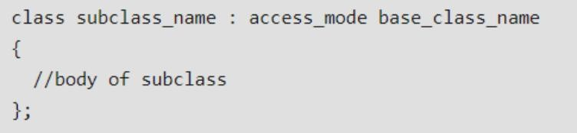
Implementing Inheritance in C++
Implementing inheritance in C++: For creating a sub-class which is inherited from the base class we have to follow the below syntax.
Here, subclass_name is the name of the sub class, access_mode is the mode in which you want to inherit this sub class for example: public, private etc. and base_class_name is the name of the base class from which you want to inherit the sub class.

Slide 8
Modes of Inheritance
Public mode: If we derive a sub class from a public base class, then the public member of the base class will become public in the derived class and protected members of the base class will become protected in derived class.
Protected mode: If we derive a sub class from a Protected base class. Then both public member and protected members of the base class will become protected in derived class.
Private mode: If we derive a sub class from a Private base class. Then both public member and protected members of the base class will become Private in derived class.

Slide 9
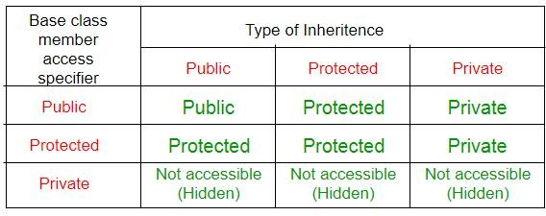
Modes of Inheritance
The below table summarizes the above three modes and shows the access specifier of the members of base class in the sub class when derived in public, protected and private modes:

Slide 10
Modes of Inheritance
class Base {
public:
int publicVar;
protected:
int protectedVar;
};
class DerivedPublic : public Base {
public:
void display() {
cout << "Public variable: " << publicVar << endl;
cout << "Protected variable: " << protectedVar << endl;
}};
int main() {
DerivedPublic obj;
obj.publicVar = 10; // Accessible (public remains public)
obj.display();
return 0;}
Here, publicVar is public in both Base and DerivedPublic, so you can access it using an object of DerivedPublic. protectedVar is protected, so it can only be accessed inside the subclass.

Slide 11
Modes of Inheritance
class Base {
public:
int publicVar;
protected:
int protectedVar;
};
class DerivedProtected : protected Base {
public:
void display() {
cout << "Public variable: " << publicVar << endl;
cout << "Protected variable: " << protectedVar << endl;
}};
int main() {
DerivedProtected obj;
// obj.publicVar = 10; // publicVar becomes protected, can’t be accessed directly
obj.display();
return 0;
}
In this case, publicVar becomes protected in DerivedProtected, so you cannot access it directly using an object of DerivedProtected, but you can still use it inside the class.
gyy

Slide 12
Modes of Inheritance
class Base {
public:
int publicVar;
protected:
int protectedVar;
};
class DerivedPrivate : private Base {
public:
void display() {
cout << "Public variable: " << publicVar << endl;
cout << "Protected variable: " << protectedVar << endl;
}};
int main() {
DerivedPrivate obj;
// obj.publicVar = 10; // Error: publicVar becomes private
obj.display();
return 0;}
In this case, both publicVar and protectedVar become private in DerivedPrivate, so they can only be accessed within the class, and not from outside.
gyy

Slide 13
Types of Inheritance

Slide 14
Types of Inheritance in C++
Single Inheritance
Multiple Inheritance
Multilevel Inheritance
Hierarchical Inheritance
Hybrid Inheritance (Virtual Inheritance)

Slide 15
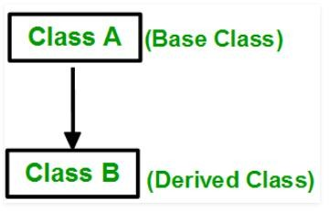
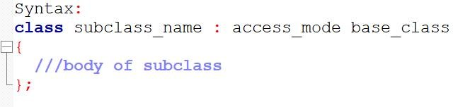
Single Inheritance
In single inheritance, a class is allowed to inherit from only one class. i.e. one sub class is inherited by one base class only.

Slide 16
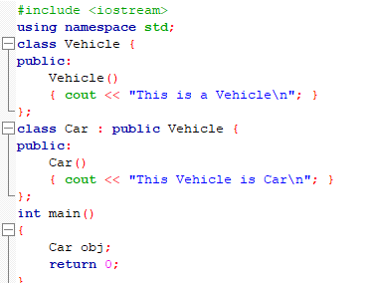

Single Inheritance

Slide 17
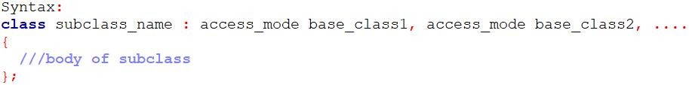

Multiple Inheritance
Multiple Inheritance is a feature of C++ where a class can inherit from more than one classes. i.e one sub class is inherited from more than one base classes.
Here, the number of base classes will be separated by a comma (‘, ‘) and the access mode for every base class must be specified and can be different.

Slide 18
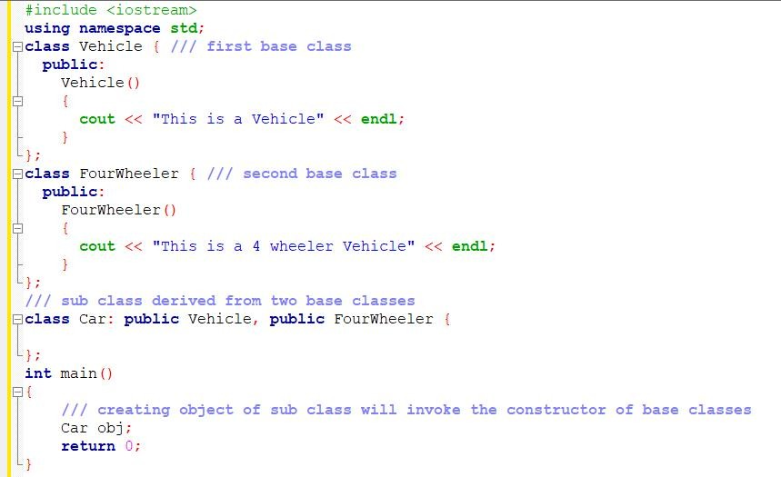
Multiple Inheritance

Slide 19
The diamond problem
The diamond problem occurs when two superclasses of a class have a common base class. For example, in the following diagram, the TA class gets two copies of all attributes of Person class, this causes ambiguities.

Slide 20
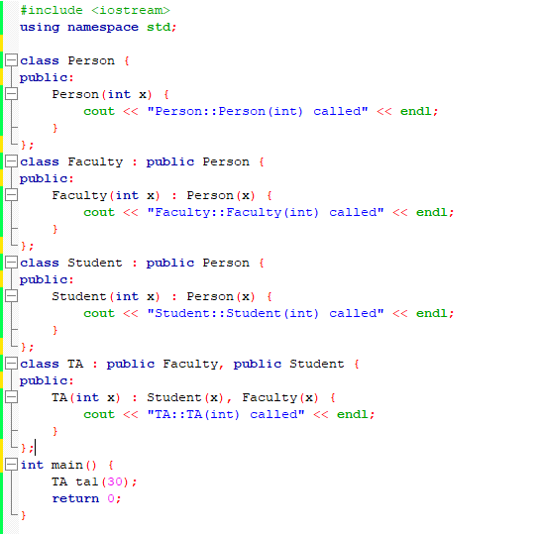
Multiple Inheritance

Slide 21
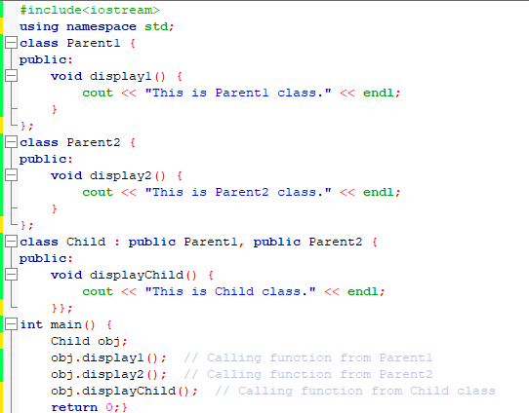
Multiple Inheritance

Slide 22
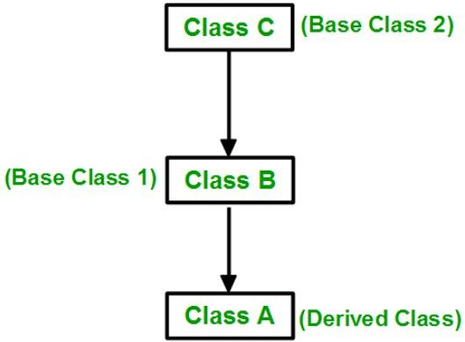
Multilevel Inheritance
In this type of inheritance, a derived class is created from another derived class.

Slide 23
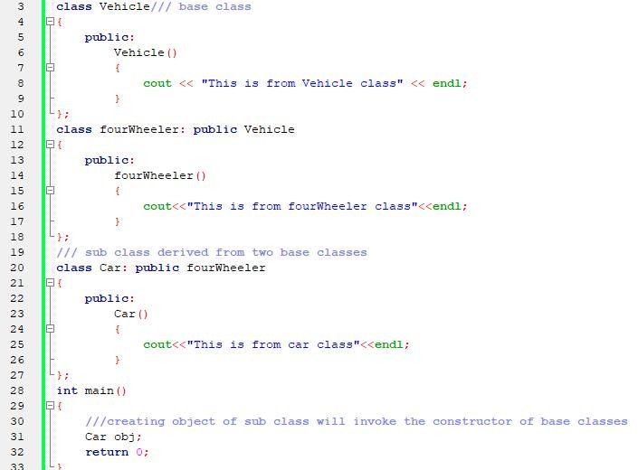
Multilevel Inheritance

Slide 24
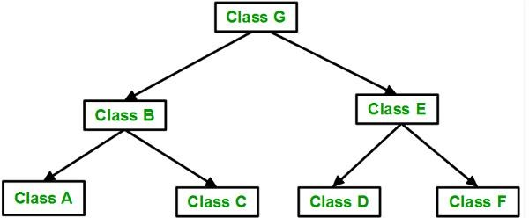
Hierarchical Inheritance
In this type of inheritance, more than one sub class is inherited from a single base class. i.e. more than one derived class is created from a single base class.

Slide 25
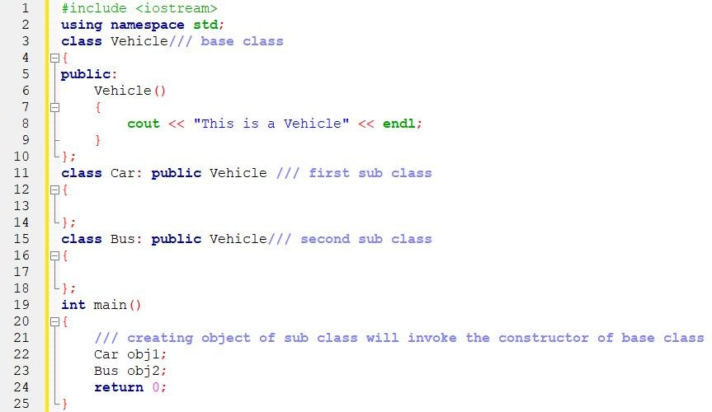
Hierarchical Inheritance

Slide 26
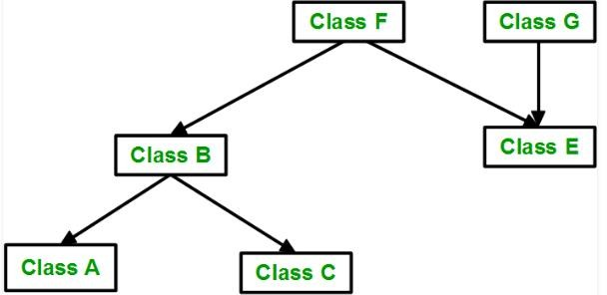
Hybrid(Virtual) Inheritance
Hybrid Inheritance is implemented by combining more than one type of inheritance.

Slide 27
Hybrid(Virtual) Inheritance
Hybrid Inheritance is implemented by combining more than one type of inheritance.

Slide 28
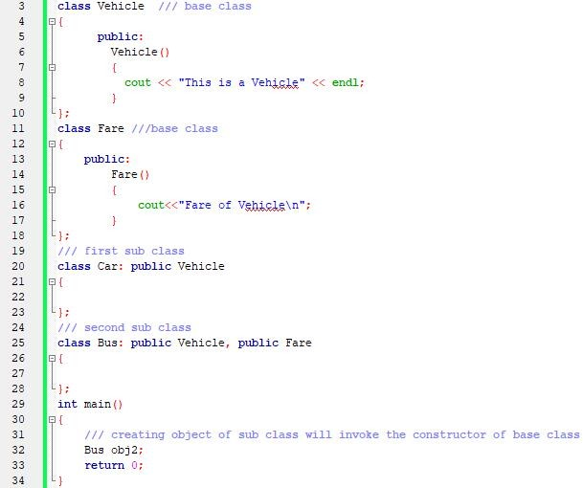
Hybrid(Virtual) Inheritance

Slide 29
Practice Example
Implement the following description using C++ language:
Create a class "Bank". Declare private variables like BankID, BankName, and Location and a class constructor that can take any two of declared parameters. And write a function Print_Values() that can print the constructor's values.
Create another class "Customer". Declare class constructor that can take two parameters like Customer_ID and Amount. And write a function Print_Values() that can print the constructor's values. Inherit the Bank class from the Customer class.
By creating the main function call the Print_Values function of the Bank class.

Slide 30
Thank You

